Slide 1
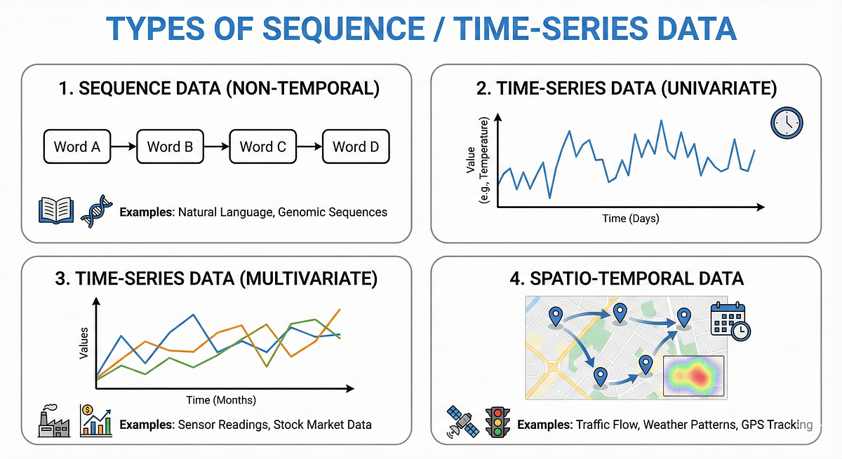
Sequence Data: Why Order Matters
Images are spatial; the relationship between pixels is based on their physical proximity.
Time-series and sentences are sequential; the meaning of a word or data point depends entirely on what came before it.
Standard Neural Networks (MLPs/CNNs) assume inputs are independent, but RNNs are designed to have "memory" of previous inputs.

Slide 2
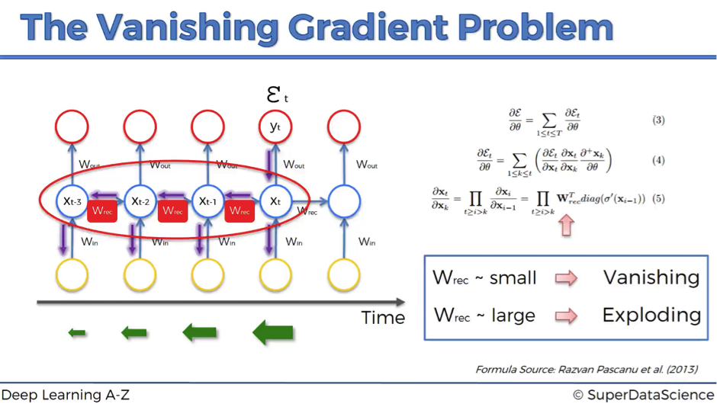
Vanishing Gradients: The Memory Limit
RNNs process sequences by passing a "hidden state" from one step to the next.
During training, gradients must be propagated back through every time step (Backpropagation Through Time).
In long sequences, these gradients are multiplied repeatedly; if they are small, they "vanish" to zero.
Result: Standard RNNs "forget" the beginning of a long sentence or pattern.

Slide 3
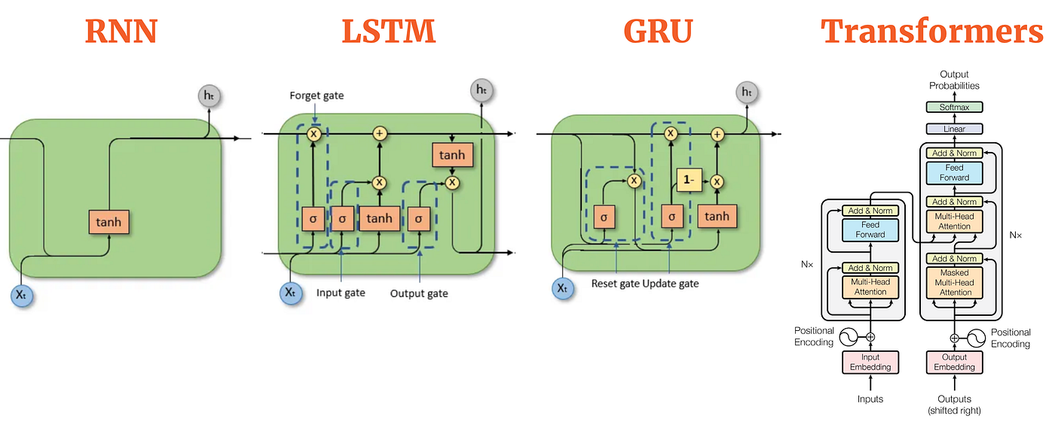
LSTMs & GRUs: Gating the Memory
LSTM (Long Short-Term Memory): Uses three "gates" (Forget, Input, Output) to regulate information flow.
Forget Gate: Decides which part of the long-term memory is no longer relevant and should be erased.
GRU (Gated Recurrent Unit): A simplified, faster version of LSTM that merges gates but maintains similar performance.
These architectures allow the network to keep relevant information across hundreds of time steps.

